Slide 1
Programming With C++/R
DST102TC
Huakang Li
Huakang.li@xjtlu.edu.cn
School of AI and Advanced Computing
Notes:
English Title: Uppercase, Calibri size 60, XJTLU Navy
English Subtitle: Uppercase, Calibri size 36, XJTLU Navy

Slide 2
Chapter 13
file input and output
Notes:
English Title: Uppercase, Calibri size 60, XJTLU Navy
English Subtitle: Uppercase, Calibri size 36, XJTLU Navy

Slide 3
Objectives
To use ofstream for output (§13.2.2) and ifstream for input (§13.2.2).
To test whether a file exists (§13.2.3).
To test the end of a file (§13.2.4).
To write data in a desired format (§13.3).
To read and write data using the getline, get, and put functions (§13.4).
To use an fstream object to read and write data (§13.5).
To open a file with specified modes (§13.5).
To use the eof(), fail(), bad(), and good() functions to test stream states (§13.6).
To understand the difference between text I/O and binary I/O (§13.7).
To write binary data using the write function (§13.7.1).
To read binary data using the read function (§13.7.2).
To cast primitive type values and objects to character arrays using the reinterpret_cast operator (§13.7).
To read/write objects (§13.7.4).
To use the seekp and seekg functions to move the file pointers for random file access (§13.8).
To open a file for both input and output to update files (§13.9).

Slide 4
Writing Data to a File
The ofstream class can be used to write primitive data type values, arrays, strings, and objects to a text file.
Listing 13.1 demonstrates how to write data. The program creates an instance of ofstream and writes two lines to the file “scores.txt”.
Each line consists of first name (a string), middle name initial (a character), last name (a string), and score (an integer).

Slide 5
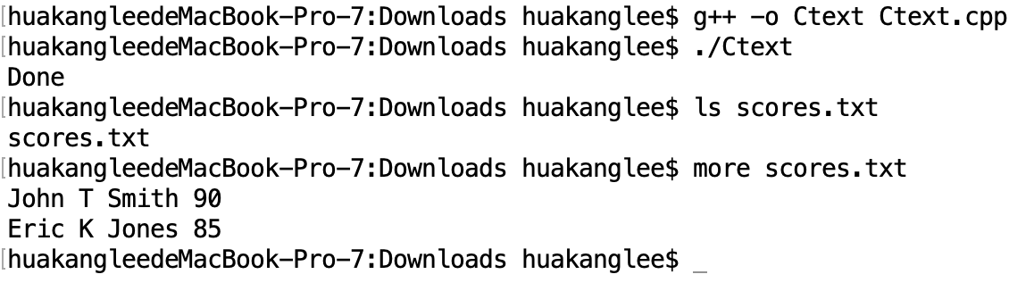
TextFileOutput.cpp
#include <iostream>
#include <fstream>
using namespace std;
int main()
{
ofstream output;
// Create a file
output.open("scores.txt");
// Write two lines
output << "John" << " " << "T" << " " << "Smith"
<< " " << 90 << endl;
output << "Eric" << " " << "K" << " " << "Jones"
<< " " << 85 << endl;
output.close();
cout << "Done" << endl;
return 0;
}

Slide 6
Writing Data to a File

Slide 7
close file
The close() function (line 16) must be used to close the stream for the object.
If this function is not invoked, the data may not be saved properly in the file.

Slide 8
file exists?
If a file already exists, the contents of the file will be destroyed without warning.

Slide 9
absolute filename
Every file is placed in a directory in the file system. An absolute file name contains a file name with its complete path and drive letter.
For example, c:\example\scores.txt is the absolute file name for the file scroes.txt on the Windows operating system.
Here c:\example is referred to as the directory path for the file. Absolute file names are machine-depende
nt. On Unix, the absolute file name may be /home/liang/example/scores.txt, where /home/liang/example is the directory path for the file scores.txt.

Slide 10
\ in file names
The directory separator for Windows is a backslash (\).
The backslash is a special character in C++ and should be written as \\ in a string literal (see Table 4.5). For example,
output.open("c:\\example\\scores.txt");

Slide 11
relative filename
Absolute file name is platform dependent.
It is better to use relative file name without drive letters.
The directory of the relative filename can be specified in the IDE if you use an IDE to run C++.

Slide 12
Reading Data from a File
The ifstream class can be used to read data from a text file.
Listing 13.2 demonstrates how to read data.
The program creates an instance of ifstream and reads data from the file scores.txt.
scores.txt was created in the preceding example.

Slide 13
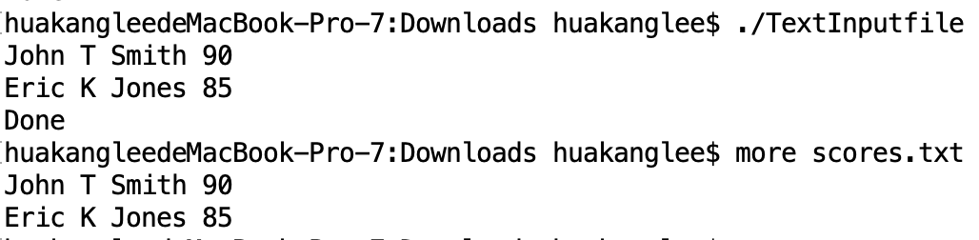
TextFileInput.cpp
#include <iostream>
#include <fstream>
#include <string>
using namespace std;
int main()
{
ifstream input("scores.txt");
// Read data
string firstName;
char mi;
string lastName;
int score;
input >> firstName >> mi >> lastName >> score;
cout << firstName << " " << mi << " " << lastName << " "
<< score << endl;
input >> firstName >> mi >> lastName >> score;
cout << firstName << " " << mi << " " << lastName << " "
<< score << endl;
input.close();
cout << "Done" << endl;
return 0;
}

Slide 14
Testing File Existence
If the file does not exist, your program will run and produce incorrect results.
Can your program check whether a file exists? Yes. You can invoke the fail() function immediately after invoking the open function.
If fail() returns true, it would indicate that the file does not exist.

Slide 15
know data format
To read data correctly, you need to know exactly how data is stored.
For example, the program in Listing 13.2 would not work if the score is a double value with a decimal point.

Slide 16
Testing End of File
Listing 13.2 reads two lines from the data file. If you don’t know how many lines are in the file and want to read them all, how do you know the end of file?
You can invoke the eof() function on the input object to detect it. Listing 13.3 reads numbers from file number.txt and displays their sum.

Slide 17
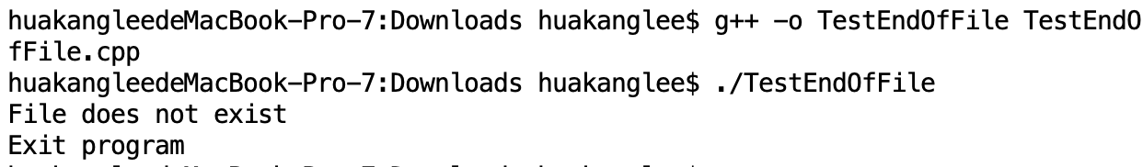
TestEndOfFile.cpp
#include <iostream>
#include <fstream>
using namespace std;
int main()
{
// Open a file
ifstream input("score.txt");
if (input.fail())
{
cout << "File does not exist" << endl;
cout << "Exit program" << endl;
return 0;
}
double sum = 0;
double number;
while (input >> number) // Read data to the end of file
{
cout << number << " "; // Display data
sum += number;
}
input.close();
cout << "\nTotal is " << sum << endl;
return 0;
}

Slide 18
Formatting Output
You have used the stream manipulators to format output to the console in §4.11, “Formatting Output.”
You can use the same stream manipulator to format output to a file.
Listing 13.4 gives an example that formats the student records to the file named formattedscores.txt.

Slide 19
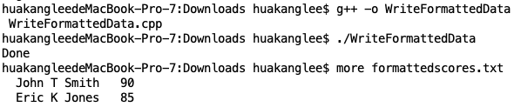
WriteFormattedData.cpp
#include <iostream>
#include <iomanip>
#include <fstream>
using namespace std;
int main()
{
ofstream output;
// Create a file
output.open("formattedscores.txt");
// Write two lines
output << setw(6) << "John" << setw(2) << "T" << setw(6) << "Smith"
<< " " << setw(4) << 90 << endl;
output << setw(6) << "Eric" << setw(2) << "K" << setw(6) << "Jones"
<< " " << setw(4) << 85;
output.close();
cout << "Done" << endl;
return 0;
}

Slide 20
getline, get and put
There is a problem to read data using the stream extraction operator (>>).
Data are delimited by whitespace. What happens if the whitepace characters are part of a string?
In §7.9.3, “Reading Strings,” you learned how to use the getline function to read a string with whitespace.
You can use the same function to read strings from a file. Recall that the syntax for the getline function is
getline(ifstream& input, string s, char delimitChar)

Slide 21
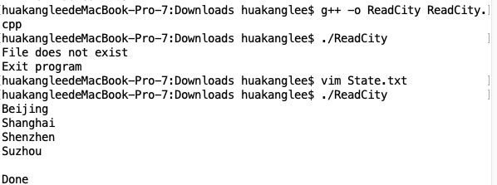
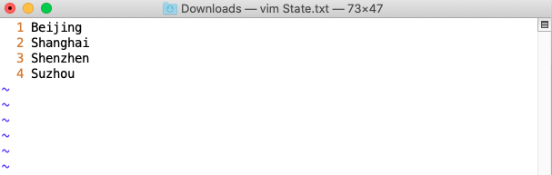
ReadCity.cpp
#include <iostream>
#include <fstream>
#include <string>
using namespace std;
int main()
{
// Open a file
ifstream input("state.txt");
if (input.fail())
{
cout << "File does not exist" << endl;
cout << "Exit program" << endl;
return 0;
}
// Read data
string city;
while (!input.eof()) // Continue if not end of file
{
getline(input, city, '#');
cout << city << endl;
}
input.close();
cout << "Done" << endl;
return 0;
}

Slide 22
getline, get and put
Two other useful functions are get and put.
You can invoke the get function on an input object to read a character and invoke the put function on an output object to write a character.
C++11: The filename can be a string or a C-string in C++11.

Slide 23
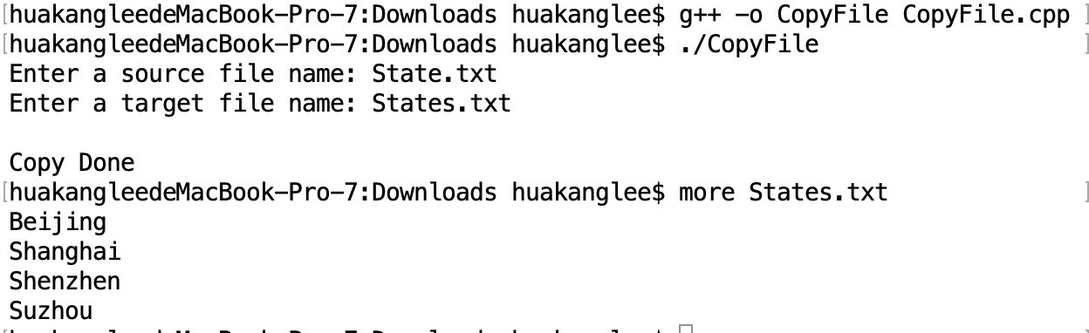
CopyFile.cpp
#include <iostream>
#include <fstream>
#include <string>
using namespace std;
int main()
{
// Enter a source file
cout << "Enter a source file name: ";
string inputFilename;
cin >> inputFilename;
// Enter a target file
cout << "Enter a target file name: ";
string outputFilename;
cin >> outputFilename;
// Create input and output streams
ifstream input(inputFilename.c_str());
ofstream output(outputFilename.c_str());
if (input.fail())
{
cout << inputFilename << " does not exist" << endl;
cout << "Exit program" << endl;
return 0;
}
char ch = input.get();
while (!input.eof()) // Continue if not end of file
{
output.put(ch);
ch = input.get(); // Read next character
}
input.close();
output.close();
cout << "\nCopy Done" << endl;
return 0;
}

Slide 24
fstream and File Open Modes
In the preceding sections, you used the ofstream to write data and the ifstream to read data. Alternatively, you can also use the fstream class to create an input stream or output stream.
It is convenient to use fstream if your program needs to use the same stream object for both input and output.
To open an fstream file, you have to specify a file mode to tell C++ how the file will be used. The file modes are listed in Table 13.1.

Slide 25
File Open Modes

Slide 26
Combining Modes
Several modes can be combined together using the | operator. This is a bitwise inclusive OR operator. See
Appendix D, “Bit Operations,” for more details. For example, to open an output file named city.txt for appending data, you can use the following statement:
stream.open("city.txt", ios::out | ios::app);

Slide 27
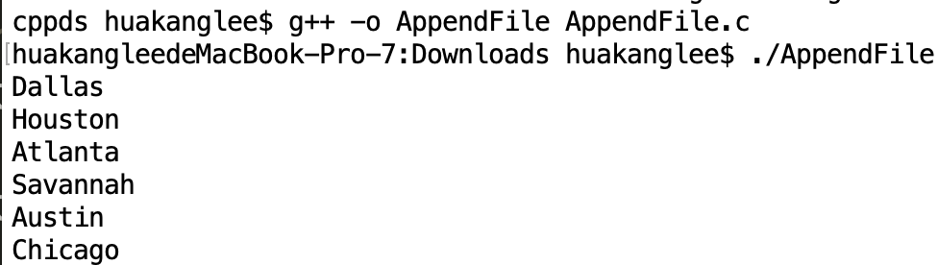
AppendFile.cpp
#include <iostream>
#include <fstream>
#include <string>
using namespace std;
int main()
{
fstream inout;
// Create a file
inout.open("city.txt", ios::out);
// Write cities
inout << "Dallas" << " " << "Houston" << " " << "Atlanta" << " ";
inout.close();
// Append to the file
inout.open("city.txt", ios::out | ios::app);
// Write cities
inout << "Savannah" << " " << "Austin" << " " << "Chicago";
inout.close();
string city;
// Open the file
inout.open("city.txt", ios::in);
while (!inout.eof()) // Continue if not end of file
{
inout >> city;
cout << city << " "<<endl;
}
inout.close();
return 0;
}

Slide 28
Testing Stream States
You have used the eof() function and fail() function to test the states of a stream.
C++ provides several more functions in a stream for testing stream states.
Each stream object contains a set of bits that act as flags.
These bit values (0 or 1) indicate the state of a stream. Table 13.2 lists these bits.

Slide 29
Stream State Bit Values

Slide 30
Stream State Functions

Slide 31
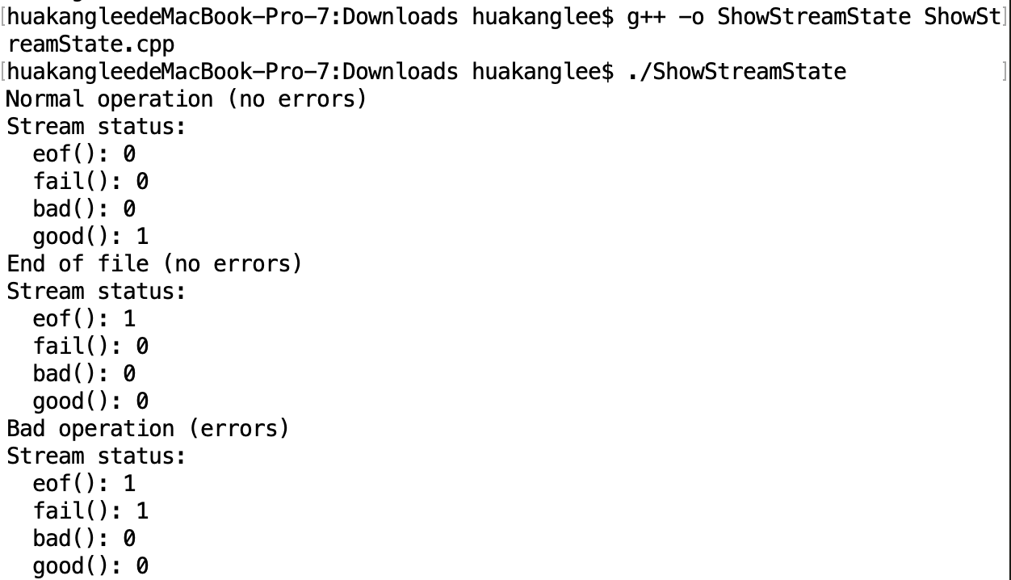
ShowStreamState.cpp
#include <iostream>
#include <fstream>
#include <string>
using namespace std;
void showState(const fstream&);
void showState(const fstream& stream)
{
cout << "Stream status: " << endl;
cout << " eof(): " << stream.eof() << endl;
cout << " fail(): " << stream.fail() << endl;
cout << " bad(): " << stream.bad() << endl;
cout << " good(): " << stream.good() << endl;
}
int main()
{
fstream inout;
// Create an output file
inout.open("temp.txt", ios::out);
inout << "Dallas";
cout << "Normal operation (no errors)" << endl;
showState(inout);
inout.close();
// Create an input file
inout.open("temp.txt", ios::in);
// Read a string
string city;
inout >> city;
cout << "End of file (no errors)" << endl;
showState(inout);
inout.close();
// Attempt to read after file closed
inout >> city;
cout << "Bad operation (errors)" << endl;
showState(inout);
return 0;
}

Slide 32
Binary I/O
Although it is not technically precise and correct, you can envision a text file as consisting of a sequence of characters and a binary file as consisting of a sequence of bits.
For example, the decimal integer 199 is stored as the sequence of three characters, '1', '9', '9', in a text file, and the same integer is stored as a byte-type value C7 in a binary file, because decimal 199 equals hex C7 (199 = 12 * 16 + 7).

Slide 33
Text vs. Binary I/O
Computers do not differentiate binary files and text files. All files are stored in binary format, and thus all files are essentially binary files.
Text I/O is built upon binary I/O to provide a level of abstraction for character encoding and decoding.

Slide 34
ios::binary
Binary I/O does not require conversions. If you write a numeric value to a file using binary I/O, the exact value in the memory is copied into the file. To perform binary I/O in C++, you have to open a file using the binary mode ios::binary. By default, a file is opened in text mode.
You used the << operator and put function to write data to a text file and the >> operator, get, and getline functions to read data from a text file. To read/write data from/to a binary file, you have to use the read and write functions on a stream.

Slide 35
The write Function
The syntax for the write function is
streamObject.write(char* bytes, int size)
Listing 13.9 shows an example of using the write function.

Slide 36
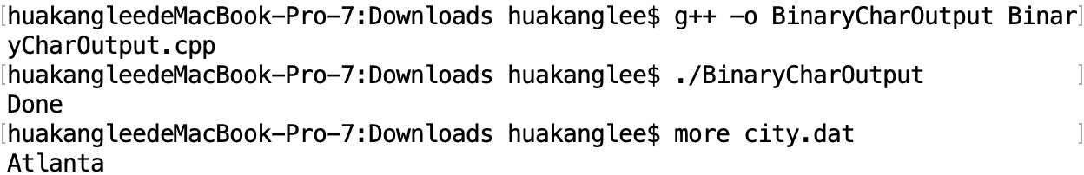
BinaryCharOutput.cpp
#include <iostream>
#include <fstream>
#include <string>
using namespace std;
int main()
{
fstream binaryio("city.dat", ios::out | ios::binary);
string s = "Atlanta";
binaryio.write(s.c_str(), s.size()); // Write s to file
binaryio.close();
cout << "Done" << endl;
return 0;
}

Slide 37
Write an Array of Bytes

Slide 38
Write Any Type
Often you need to write data other than characters. How can you accomplish it? C++ provides the reinterpret_cast for this purpose. You can use this operator to cast the address of a primitive type value or an object to a character array pointer for binary I/O. The syntax of this type of casting is:
reinterpret_cast<dataType>(address)
where address is the starting address of the data (primitive, array, or object) and dataType is the data type you are converting to. In this case for binary I/O, it is char *.

Slide 39
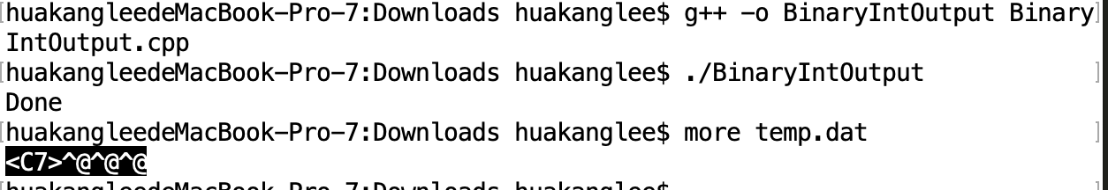
BinaryIntOutput.cpp
#include <iostream>
#include <fstream>
using namespace std;
int main()
{
fstream binaryio("temp.dat", ios::out | ios::binary);
int value = 199;
binaryio.write(reinterpret_cast<char*>(&value), sizeof(value));
binaryio.close();
cout << "Done" << endl;
return 0;
}

Slide 40
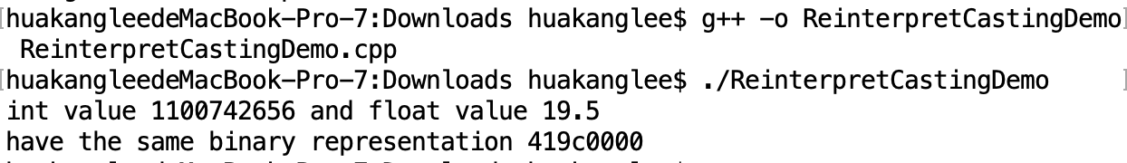
Reinterpret_cast Demo
ReinterpretCastingDemo.cpp
#include <iostream>
#include <iomanip>
using namespace std;
int main()
{
float floatValue = 19.5;
int* p = reinterpret_cast<int*>(&floatValue);
cout << "int value " << *p << " and float value "
<< floatValue << "\nhave the same binary representation "
<< hex << *p << endl;
return 0;
}

Slide 41
The read Function
The syntax for the read function is
streamObject.read(char* address, int size)
Assume the file city.dat was created in Listing 13.9. Listing 13.11 reads the characters using the read function.

Slide 42
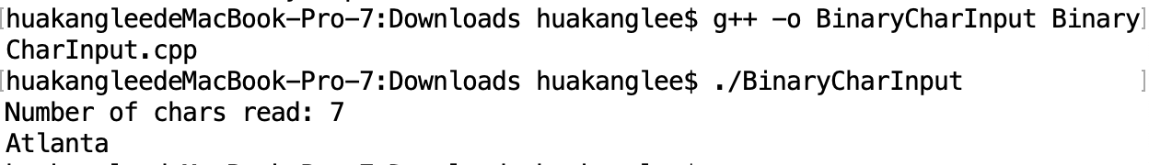
BinaryCharInput.cpp
#include <iostream>
#include <fstream>
using namespace std;
int main()
{
fstream binaryio("city.dat", ios::in | ios::binary);
char s[10];
binaryio.read(s, 10);
cout << "Number of chars read: " << binaryio.gcount() << endl;
s[binaryio.gcount()] = '\0'; // Append a C-string terminator
cout << s << endl;
binaryio.close();
return 0;
}

Slide 43
Read Any Type
Similarly, to read data other than characters, you need to use the reinterpret_cast operator.
Assume that the file temp.dat was created in Listing 13.13. Listing 13.12 reads the integer using the read function.

Slide 44
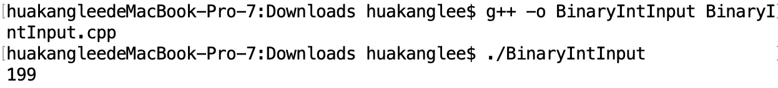
BinaryIntInput.cpp
#include <iostream>
#include <fstream>
using namespace std;
int main()
{
fstream binaryio("temp.dat", ios::in | ios::binary);
int value;
binaryio.read(reinterpret_cast<char*>(&value), sizeof(value));
cout << value << endl;
binaryio.close();
return 0;
}

Slide 45
Binary Array I/O
This section gives an example in Listing 13.13 to write an array of double values to a binary file, and read it back from the file.

Slide 46
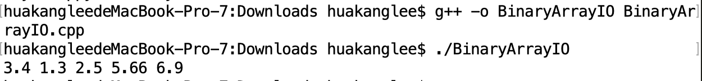
BinaryArrayIO.cpp
#include <iostream>
#include <fstream>
using namespace std;
int main()
{
const int SIZE = 5; // Array size
fstream binaryio; // Create stream object
// Write array to the file
binaryio.open("array.dat", ios::out | ios::binary);
double array[SIZE] = {3.4, 1.3, 2.5, 5.66, 6.9};
binaryio.write(reinterpret_cast<char*>(&array), sizeof(array));
binaryio.close();
// Read array from the file
binaryio.open("array.dat", ios::in | ios::binary);
double result[SIZE];
binaryio.read(reinterpret_cast<char*>(&result), sizeof(result));
binaryio.close();
// Display array
for (int i = 0; i < SIZE; i++)
cout << result[i] << " ";
cout<<endl;
return 0;
}

Slide 47
Binary Object I/O
Listing 13.1 writes student records into a text file. A student record consists of first name, middle name initial, last name, and score. These fields are written to the file separately.
A better way to process it is to declare a class to model records. Each record is an object of the Student class.

Slide 48
Binary Object I/O, cont.

Slide 49
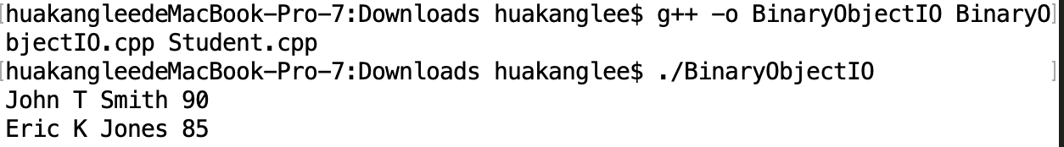
BinaryObjectIO.cpp
#include <iostream>
#include <fstream>
#include "Student.h"
using namespace std;
void displayStudent(const Student& student)
{
cout << student.getFirstName() << " ";
cout << student.getMi() << " ";
cout << student.getLastName() << " ";
cout << student.getScore() << endl;
}
int main()
{
fstream binaryio; // Create stream object
binaryio.open("student.dat", ios::out | ios::binary);
Student student1("John", 'T', "Smith", 90);
Student student2("Eric", 'K', "Jones", 85);
Student student3("Susan", 'T', "King", 67);
Student student4("Kim", 'K', "Peterson", 95);
binaryio.write(reinterpret_cast<char*>
(&student1), sizeof(Student));
binaryio.write(reinterpret_cast<char*>
(&student2), sizeof(Student));
binaryio.write(reinterpret_cast<char*>
(&student3), sizeof(Student));
binaryio.write(reinterpret_cast<char*>
(&student4), sizeof(Student));
binaryio.close();
// Read student back from the file
binaryio.open("student.dat", ios::in | ios::binary);
Student studentNew;
binaryio.read(reinterpret_cast<char*>
(&studentNew), sizeof(Student));
displayStudent(studentNew);
binaryio.read(reinterpret_cast<char*>
(&studentNew), sizeof(Student));
displayStudent(studentNew);
binaryio.close();
return 0;
}

Slide 50
void Student::setLastName(const string& s)
{
strcpy(lastName, s.c_str());
}
void Student::setScore(int score)
{
this->score = score;
}
string Student::getFirstName() const
{
return string(firstName);
}
char Student::getMi() const
{
return mi;
}
string Student::getLastName() const
{
return string(lastName);
}
int Student::getScore() const
{
return score;
}
Student.h
Student.cpp
#ifndef STUDENT_H
#define STUDENT_H
#include <string>
using namespace std;
class Student
{
public:
Student();
Student(const string& firstName, char mi,
const string& lastName, int score);
void setFirstName(const string& s);
void setMi(char mi);
void setLastName(const string& s);
void setScore(int score);
string getFirstName() const;
char getMi() const;
string getLastName() const;
int getScore() const;
private:
char firstName[25];
char mi;
char lastName[25];
int score;
};
#endif
#include "Student.h"
#include <cstring>
// Construct a default student
Student::Student()
{
}
// Construct a Student object with specified data
Student::Student(const string& firstName, char mi,
const string& lastName, int score)
{
setFirstName(firstName);
setMi(mi);
setLastName(lastName);
setScore(score);
}
void Student::setFirstName(const string& s)
{
strcpy(firstName, s.c_str());
}
void Student::setMi(char mi)
{
this->mi = mi;
}

Slide 51
Random Access File
A file consists of a sequence of bytes. There is a special marker called file pointer that is positioned at one of these bytes. A read or write operation takes place at the location of the file pointer.
When a file is opened, the file pointer is set at the beginning of the file. When you read or write data to the file, the file pointer moves forward to the next data item.
For example, if you read a character using the get() function, C++ reads one byte from the file pointer and now the file pointer is 1 byte ahead of the previous location.

Slide 52
Random Access File, cont

Slide 53
seekp, seekg, tellp, tellg

Slide 54
Random Access File Example
Listing 13.17 demonstrates how to access file randomly. The program first stores 10 student objects into the file, and then retrieves the 3rd student from the file.

Slide 55
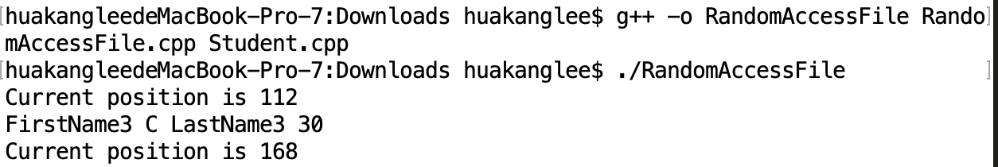
RandomAccessFile.cpp
binaryio.write(reinterpret_cast<char*>
(&student1), sizeof(Student));
binaryio.write(reinterpret_cast<char*>
(&student2), sizeof(Student));
binaryio.write(reinterpret_cast<char*>
(&student3), sizeof(Student));
binaryio.write(reinterpret_cast<char*>
(&student4), sizeof(Student));
binaryio.write(reinterpret_cast<char*>
(&student5), sizeof(Student));
binaryio.write(reinterpret_cast<char*>
(&student6), sizeof(Student));
binaryio.write(reinterpret_cast<char*>
(&student7), sizeof(Student));
binaryio.write(reinterpret_cast<char*>
(&student8), sizeof(Student));
binaryio.write(reinterpret_cast<char*>
(&student9), sizeof(Student));
binaryio.write(reinterpret_cast<char*>
(&student10), sizeof(Student));
binaryio.close();
// Read student back from the file
binaryio.open("student.dat", ios::in | ios::binary);
Student studentNew;
binaryio.seekg(2 * sizeof(Student));
cout << "Current position is " << binaryio.tellg() << endl;
binaryio.read(reinterpret_cast<char*>
(&studentNew), sizeof(Student));
displayStudent(studentNew);
cout << "Current position is " << binaryio.tellg() << endl;
binaryio.close();
return 0;
}
#include <iostream>
#include <fstream>
#include "Student.h"
using namespace std;
void displayStudent(const Student& student)
{
cout << student.getFirstName() << " ";
cout << student.getMi() << " ";
cout << student.getLastName() << " ";
cout << student.getScore() << endl;
}
int main()
{
fstream binaryio; // Create stream object
binaryio.open("student.dat", ios::out | ios::binary);
Student student1("FirstName1", 'A', "LastName1", 10);
Student student2("FirstName2", 'B', "LastName2", 20);
Student student3("FirstName3", 'C', "LastName3", 30);
Student student4("FirstName4", 'D', "LastName4", 40);
Student student5("FirstName5", 'E', "LastName5", 50);
Student student6("FirstName6", 'F', "LastName6", 60);
Student student7("FirstName7", 'G', "LastName7", 70);
Student student8("FirstName8", 'H', "LastName8", 80);
Student student9("FirstName9", 'I', "LastName9", 90);
Student student10("FirstName10", 'J', "LastName10", 100);

Slide 56
Updating Files
Listing 13.18 demonstrates how to update a file. Suppose file object1.dat has already been created with ten Student objects from Listing 10.17. The program first reads the 2nd student from the file, changes the last name, writes the revised object back to the file, and reads the new object back from the file.

Slide 57
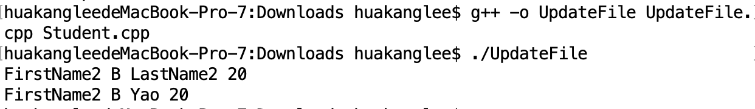
UpdateFile.cpp
#include <iostream>
#include <fstream>
#include "Student.h"
using namespace std;
void displayStudent(const Student& student)
{
cout << student.getFirstName() << " ";
cout << student.getMi() << " ";
cout << student.getLastName() << " ";
cout << student.getScore() << endl;
}
int main()
{
fstream binaryio; // Create stream object
// Open file for input and output
binaryio.open("student.dat", ios::in | ios::out | ios::binary);
Student student1;
binaryio.seekg(sizeof(Student));
binaryio.read(reinterpret_cast<char*>
(&student1), sizeof(Student));
displayStudent(student1);
student1.setLastName("Yao");
binaryio.seekp(sizeof(Student));
binaryio.write(reinterpret_cast<char*>
(&student1), sizeof(Student));
Student student2;
binaryio.seekg(sizeof(Student));
binaryio.read(reinterpret_cast<char*>
(&student2), sizeof(Student));
displayStudent(student2);
binaryio.close();
return 0;
}

Slide 58
summarization
Writing file
File Exists
Reading file
Data Format
Fstream
Binary I/O
Write Array
Objest I/O

Slide 59



THANK YOU
Visit us
FOLLOW us
www.xjtlu.edu.cn
Notes:
Title: Uppercase, Calibri size 60, XJTLU Navy

